Slide 1
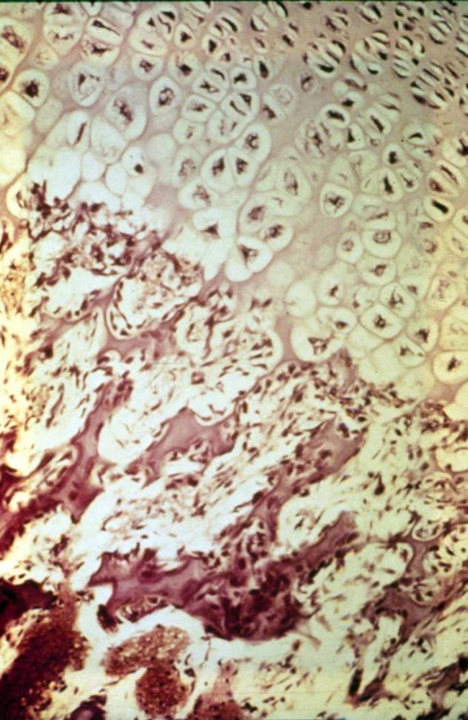
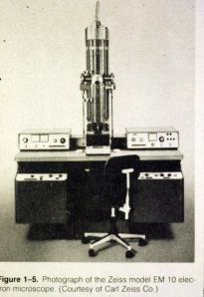
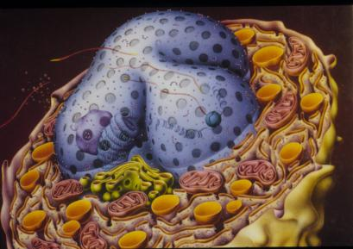
1. Introduction to Cells, Tissues, and organs
Undergraduate – Graduate
Histology Lecture Series
Larry Johnson, Professor
Veterinary Integrative Biosciences
Texas A&M University
College Station, TX 77843

Slide 2
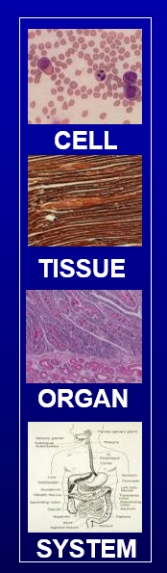



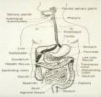
Introduction to HISTOLOGY
PROTOPLASM – Living Substance
CELL – Smallest unit of protoplasm
Simplest animals consist of a single cell.
CELL
TISSUE – Groups of cells with same general function and texture (texture = tissue)
  e.g., muscle, nerve, connective tissue, epithelium
TISSUE
ORGAN – Two or more types of tissues; larger functional unit
  e.g., skin, kidney, intestine, blood vessels
ORGAN
ORGAN SYSTEM - Several organs
  e.g., respiratory, digestive, reproductive systems
SYSTEM

Slide 3
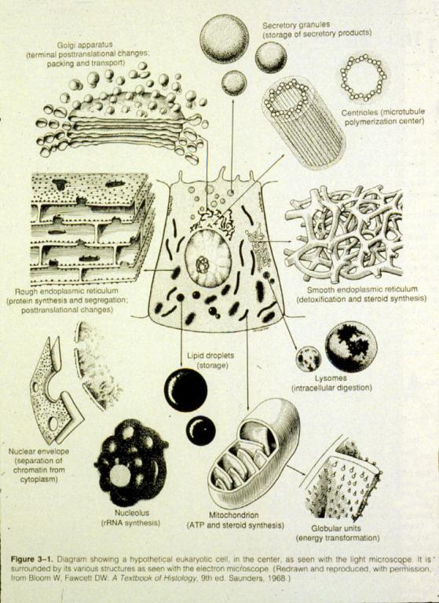
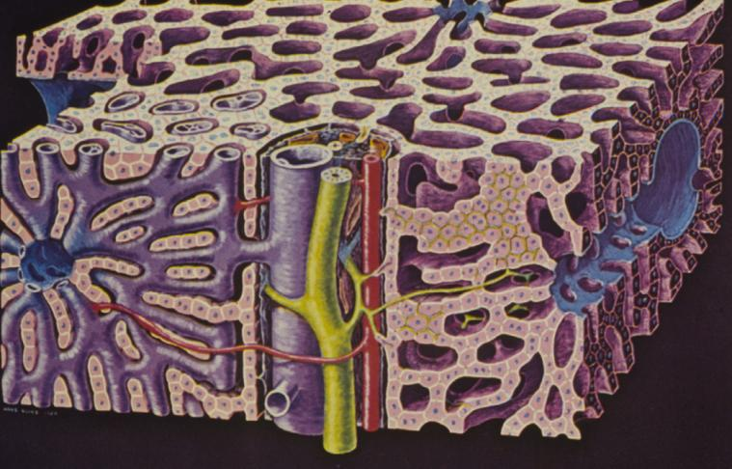
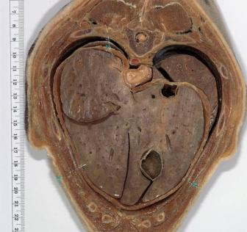
tissue
organ
cell
organ system

Slide 4
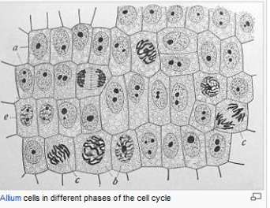

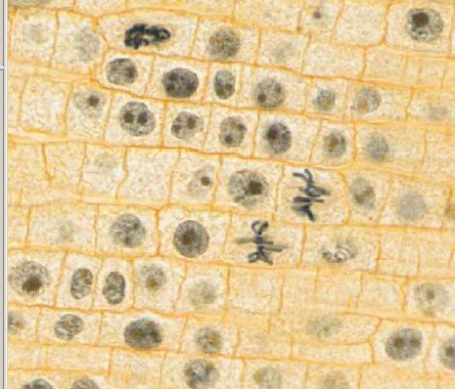
In the 1660s, Robert Hooke looked through a primitive microscope at a thinly cut piece of cork. He saw a series of walled boxes that reminded him of the tiny rooms, or cellula, occupied by monks, and he coined the word "cell.“
Onion Root Mitosis
Cells
in a →
plant
Although animal cells do not have cell walls like plants, cells are the “building blocks of life” of both.

Slide 5
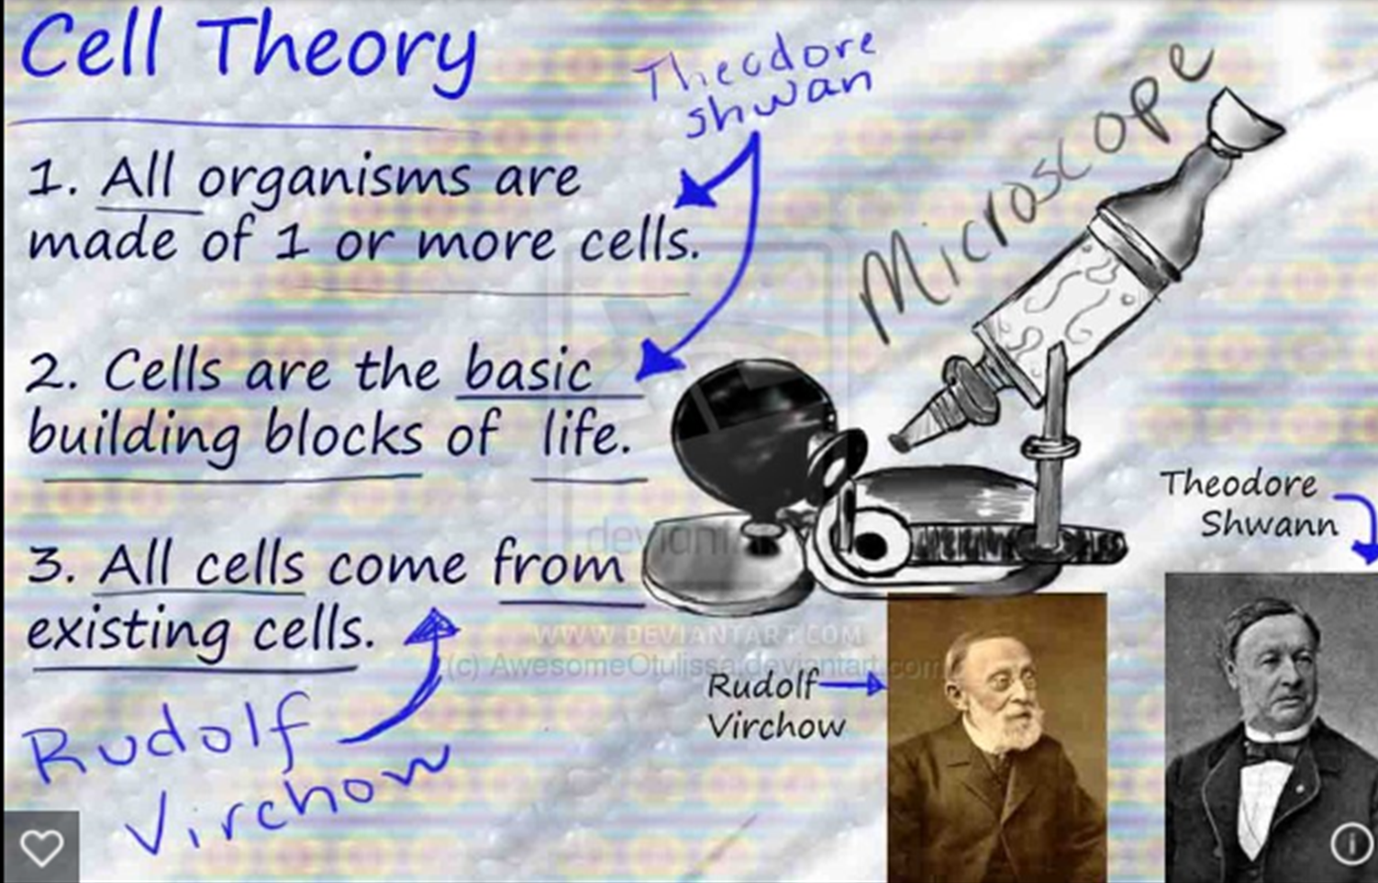

Slide 6
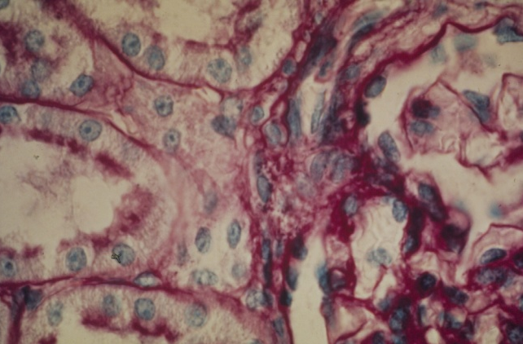
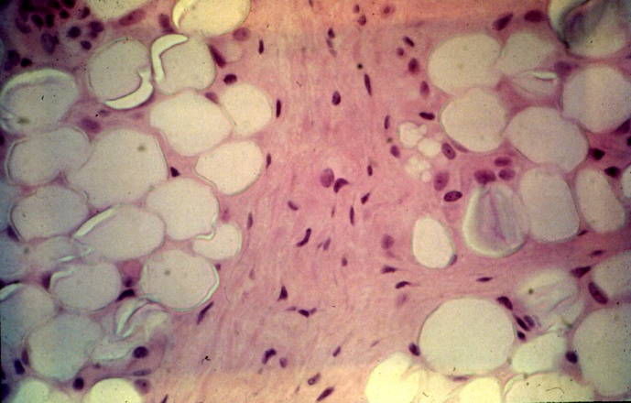
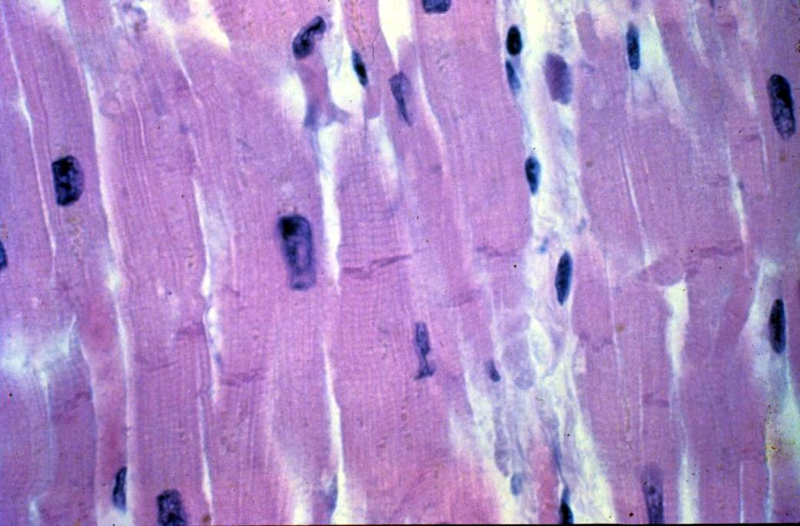
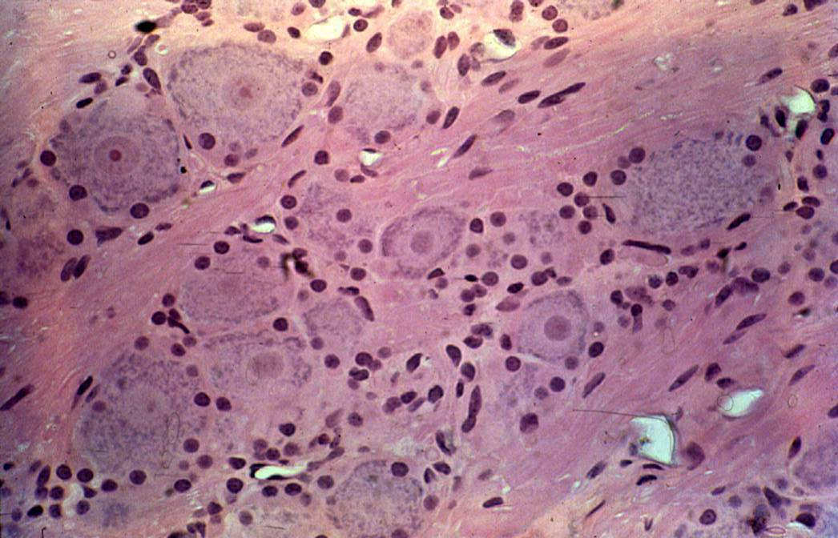
FOUR BASIC TYPES OF TISSUES IN THE BODY
-----------------------------------------------
Epithelium Connective tissue
Muscular tissue Nervous tissue

Slide 7
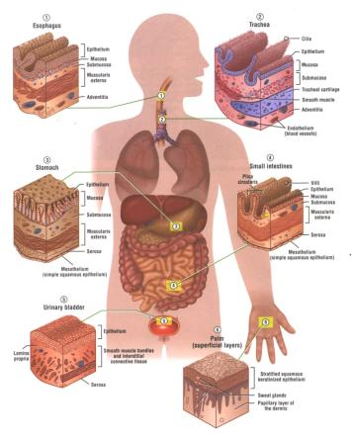
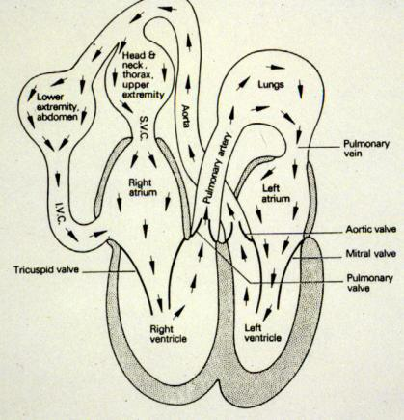
Epithelium
Functions:
Cover organs, line viscera and blood vessels, secretory cells of glands

Slide 8
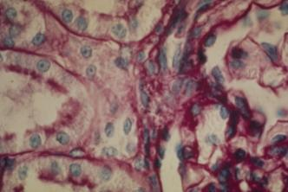
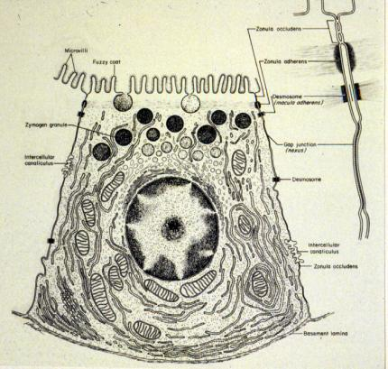
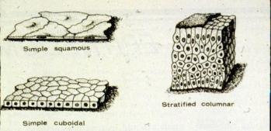
Epithelium
Distinguishing features and distribution:
  Always sit on a basement membrane, but come in a variety of configurations: classified on the basis of their shape and of the surface cells and whether one (simple) or more (stratified) layers of cells are stacked upon each other.
  These cells are always attached to their neighbors by desmosomes, tight junctions, and gap junctions.

Slide 9
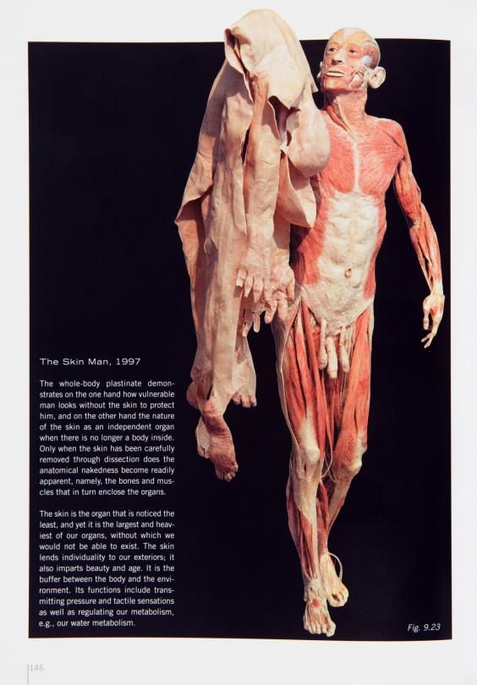
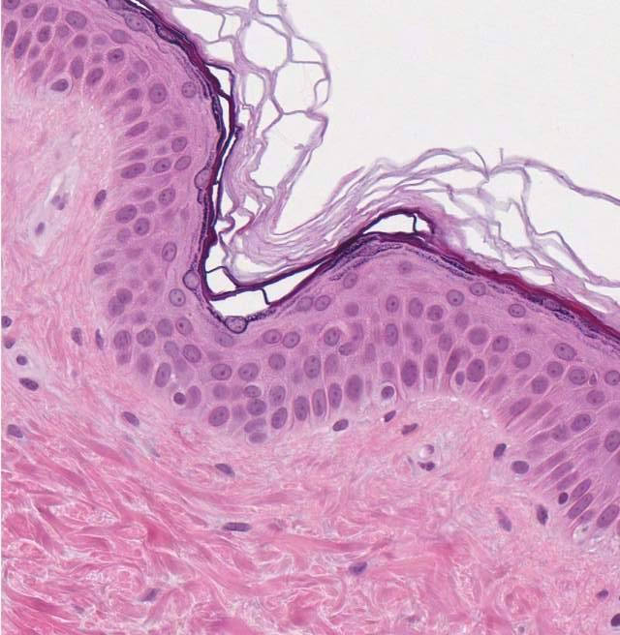

EPITHELIUM
CONNECTIVE TISSUE
Skin
Gunther von Hagens’
BODY WORLDS

Slide 10

CONNECTIVE TISSUE

Slide 11
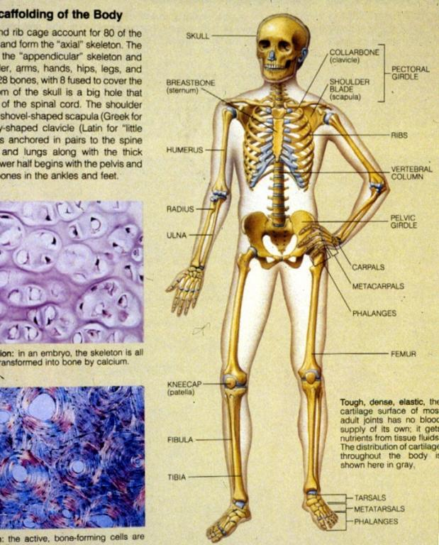

Slide 12
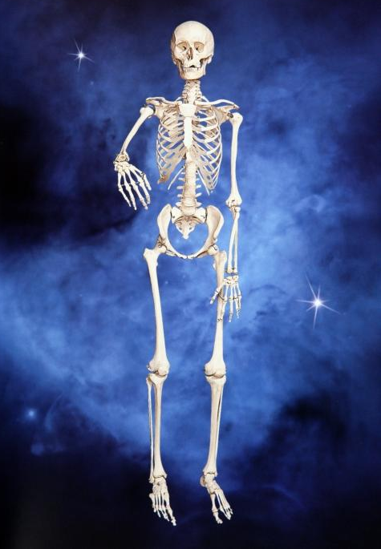
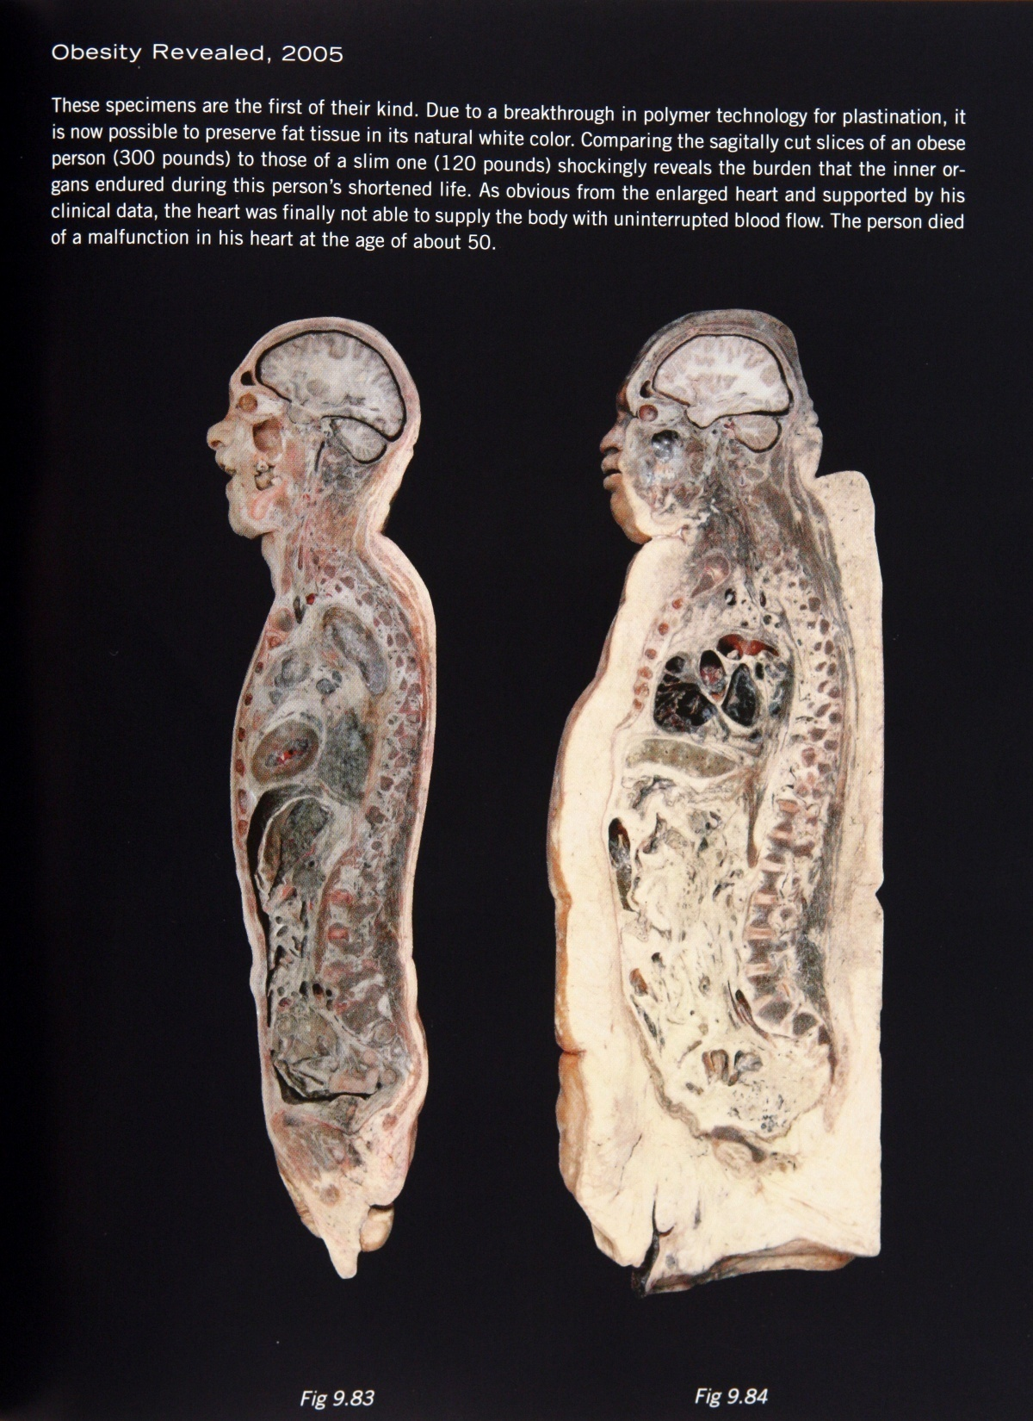

Fat
Muscle
Gunther von Hagens’ Body Worlds

Slide 13
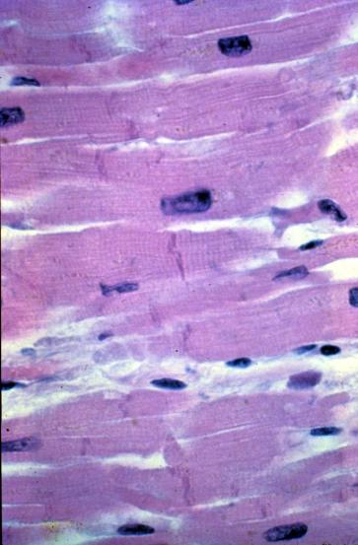
Muscle
Function:
generation of contractile force.
Distinguishing features:
  High concentration of contractile proteins actin and myosin arranged either diffusely in the cytoplasm (smooth muscle) or in regular repeating units called sarcomeres (striated muscles, e.g., cardiac and skeletal muscles).

Slide 14
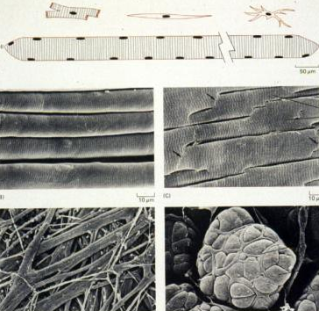
Muscle
Histological identification:
  Skeletal muscle – very long cylindrical striated muscle cells with multiple peripheral nuclei
  Cardiac muscle – short branching striated muscle cells with one or two centrally located nuclei
  Smooth muscle – closely packed spindle-shaped cells with a single centrally placed nucleus and cytoplasm that appears homogeneous by light microscopy

Slide 15
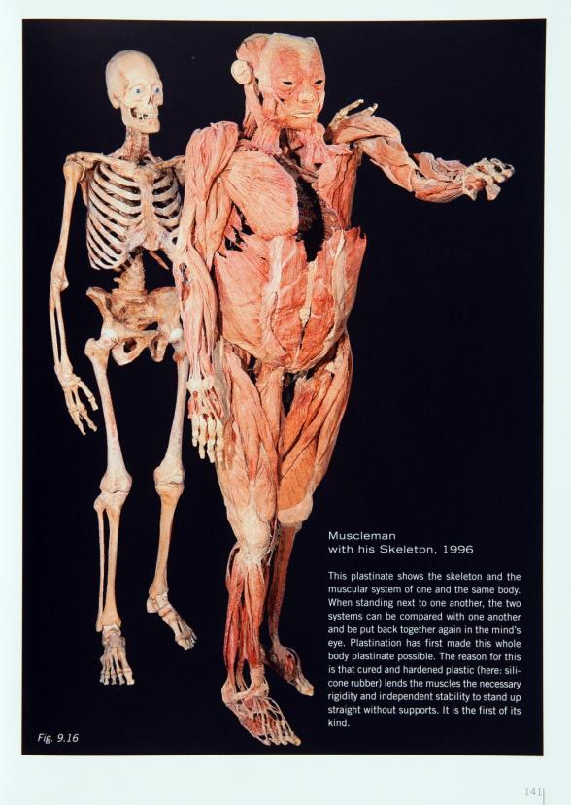
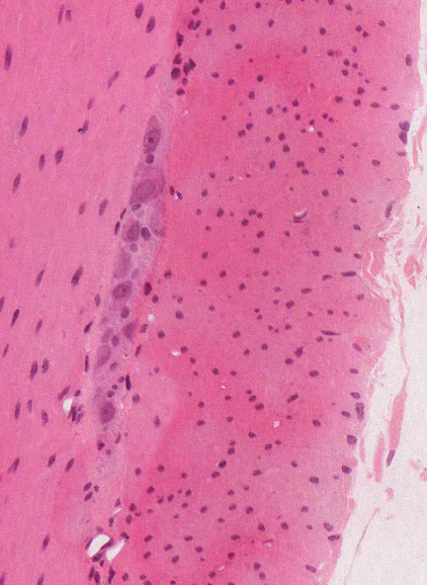
Smooth muscle
NERVOUS
TISSUE
Gunther von Hagens’
Body Worlds

Slide 16
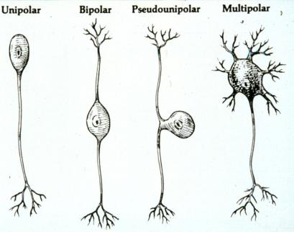
Nervous Tissue
Functions:
specialized for the transmission,
reception, and integration of
electrical impulses
Distinguishing features:
  neurons – very large excitable cells with long processes called axons and dendrites. The axons make contact with other neurons or muscle cells at a specialization called a synapse where the impulses are either electrically or chemically transmitted to other neurons or various target cells (e.g., muscle). Others secrete hormones.

Slide 17
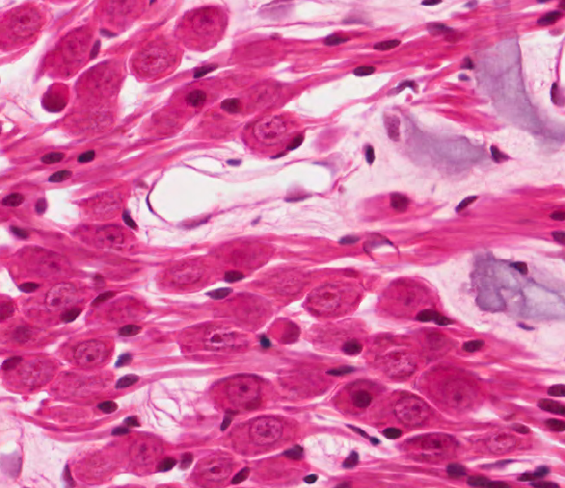
Nervous Tissue
Bipolar neurons
of inner ear

Slide 18
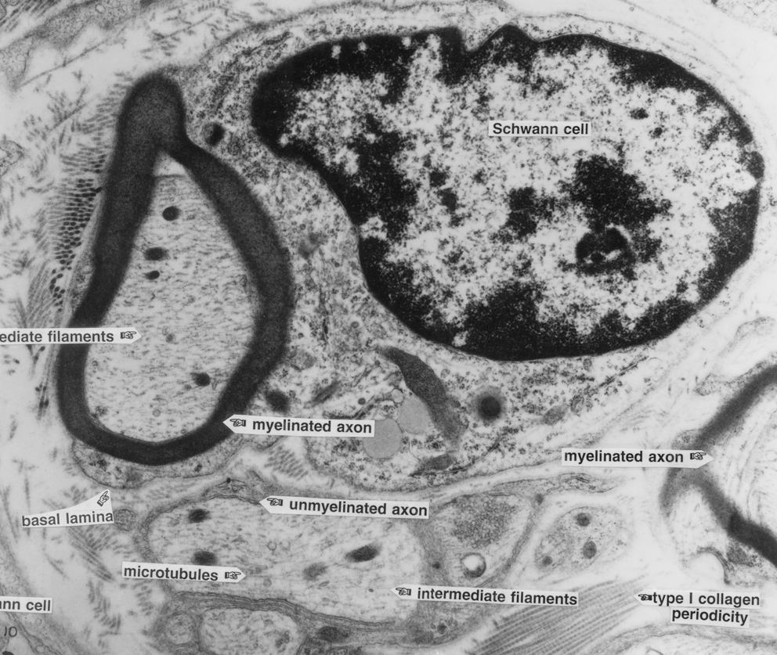
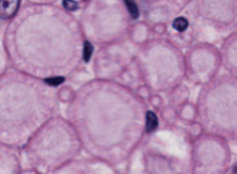
Nervous Tissue
  Glial cells – the supporting cells of nervous tissue.
  Nerves – collections of neuronal processes bound together by connective tissue. Axons may be coated by a myelin sheath (“myelinated”) or simply protected by being cradled in an indentation of a glial cell (“unmyelinated”).
Myelinated
Unmyelinated?

Slide 19

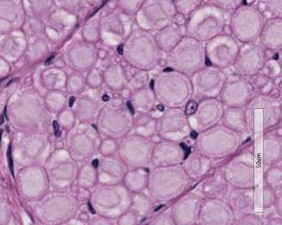
Nervous Tissue
  Nerves – collections of neuronal processes bound together by connective tissue. Axons may be coated by a myelin sheath (“myelinated”)
DEMO SLIDE BOX 78

Slide 20
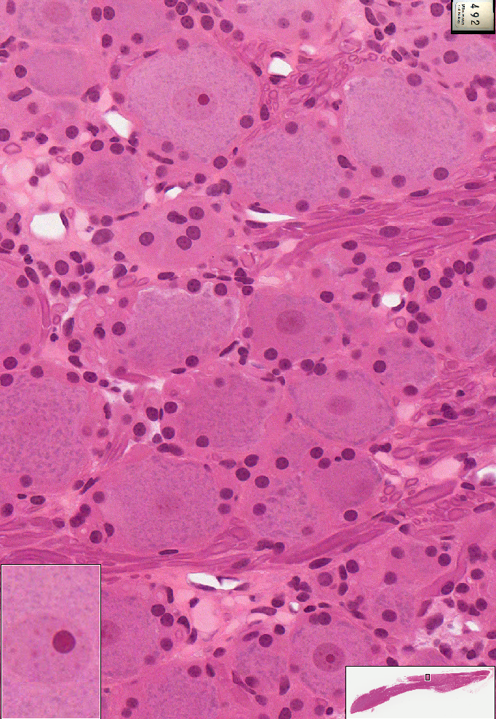
Nervous Tissue
Distribution:
  Comprise the central nervous system
  Individual peripheral nerves are found throughout the body
  Individual neurons and clusters of neurons (called ganglia) are found in most organs

Slide 21
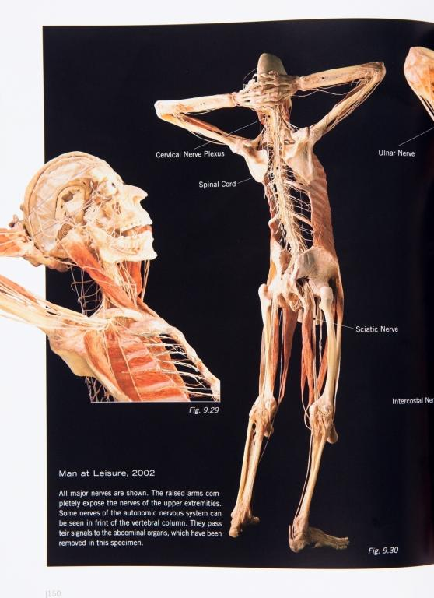
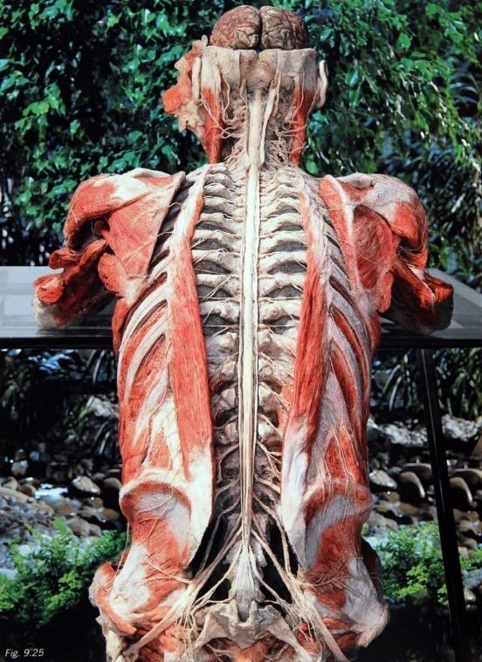
Gunther von Hagens’
Body Worlds

Slide 22
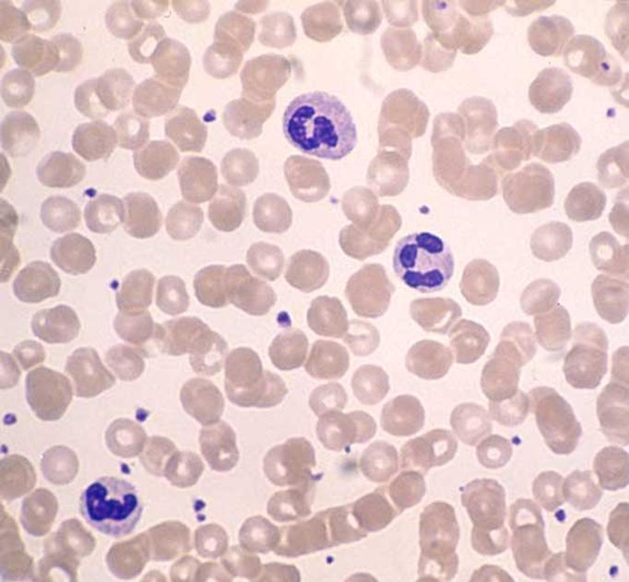
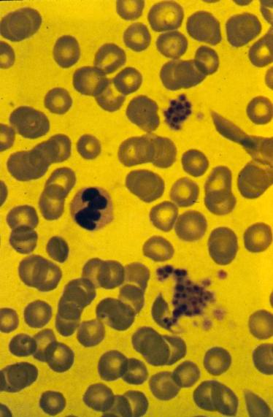
Blood cells -functions
(classified as connective tissue)
Functions:
  Red cells – carry oxygen to the tissues and CO₂ from tissues
  White cells – transient inhabitants of the blood which are manufactured in bone marrow and pass through the blood to connective tissue where they participate in defense against biological and chemical invaders
  Platelets – blood clotting

Slide 23
Blood cells
(classified as connective tissue)
Distinguishing features and histological identification:
red cells – biconcave discs containing hemoglobin
white cells – granulocytes have one of three different types of granules and lobed nuclei; lymphocytes and monocytes have few granules and round or indented nuclei
platelets – anucleate cell fragments produced by megakaryocytes in the bone marrow

Slide 24
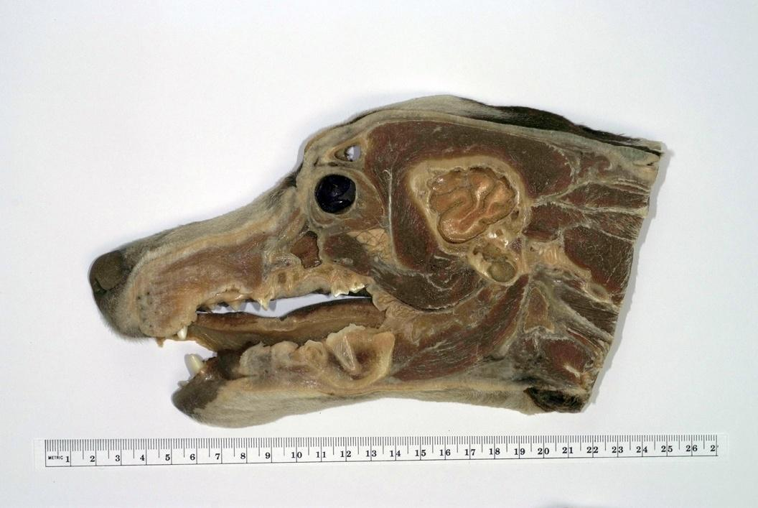
Where are these basic tissues located?
EPITHELIUM
CONNECTIVE TISSUE
MUSCULAR TISSUE
NERVOUS TISSUE
Epithelium

Slide 25
Where are these basic tissues located?
EPITHELIUM
CONNECTIVE TISSUE
MUSCULAR TISSUE
NERVOUS TISSUE
Connective tissue

Slide 26
Where are these basic tissues located?
EPITHELIUM
CONNECTIVE TISSUE
MUSCULAR TISSUE
NERVOUS TISSUE
Muscular
tissue

Slide 27
Where are these basic tissues located?
EPITHELIUM
CONNECTIVE TISSUE
MUSCULAR TISSUE
NERVOUS TISSUE
NERVOUS
TISSUE

Slide 28
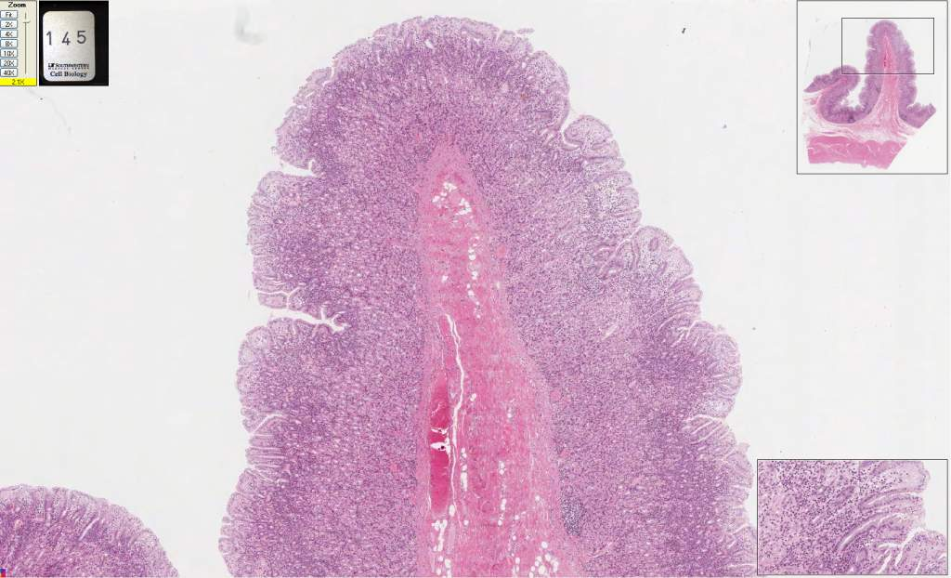
Fundic stomach (H&E)
145

Slide 29
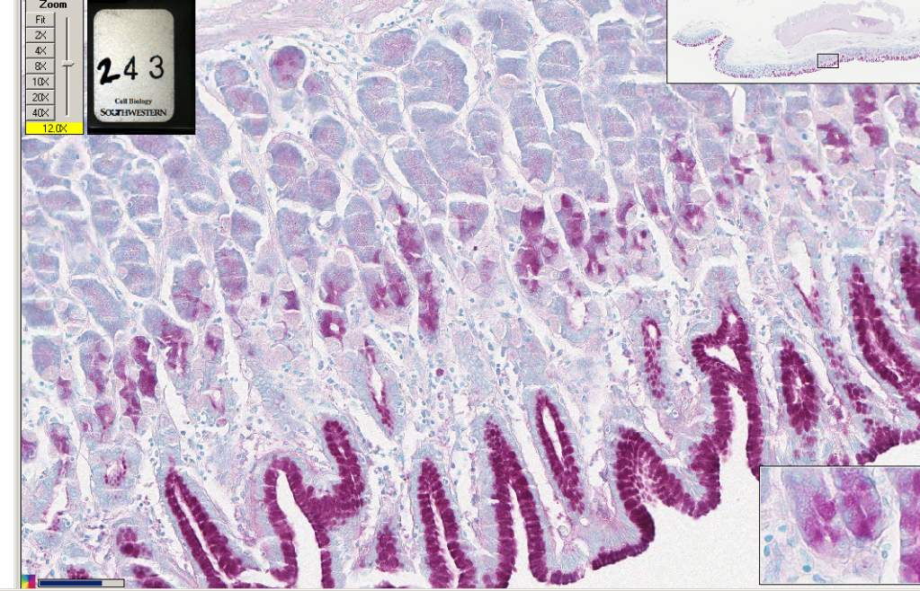
Fundic stomach, monkey (PAS)
243

Slide 30
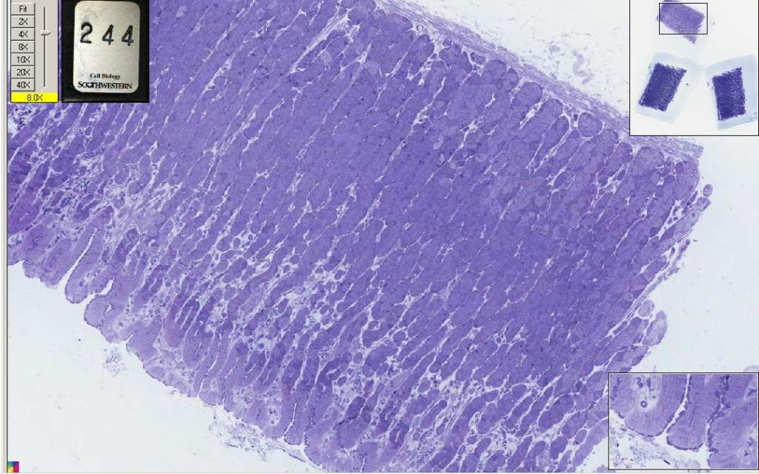
Surface mucus cells of Fundic stomach, rabbit (toluidine blue)
244

Slide 31
Many illustrations in these VIBS Histology YouTube videos were modified from the following books and sources: Many thanks to original sources!
Bruce Alberts, et al. 1983. Molecular Biology of the Cell. Garland Publishing, Inc., New York, NY.
Bruce Alberts, et al. 1994. Molecular Biology of the Cell. Garland Publishing, Inc., New York, NY.
William J. Banks, 1981. Applied Veterinary Histology. Williams and Wilkins, Los Angeles, CA.
Hans Elias, et al. 1978. Histology and Human Microanatomy. John Wiley and Sons, New York, NY.
Don W. Fawcett. 1986. Bloom and Fawcett. A textbook of histology. W. B. Saunders Company, Philadelphia, PA.
Don W. Fawcett. 1994. Bloom and Fawcett. A textbook of histology. Chapman and Hall, New York, NY.
Arthur W. Ham and David H. Cormack. 1979. Histology. J. S. Lippincott Company, Philadelphia, PA.
Luis C. Junqueira, et al. 1983. Basic Histology. Lange Medical Publications, Los Altos, CA.
L. Carlos Junqueira, et al. 1995. Basic Histology. Appleton and Lange, Norwalk, CT.
L.L. Langley, et al. 1974. Dynamic Anatomy and Physiology. McGraw-Hill Book Company, New York, NY.
W.W. Tuttle and Byron A. Schottelius. 1969. Textbook of Physiology. The C. V. Mosby Company, St. Louis, MO.
Leon Weiss. 1977. Histology Cell and Tissue Biology. Elsevier Biomedical, New York, NY.
Leon Weiss and Roy O. Greep. 1977. Histology. McGraw-Hill Book Company, New York, NY.
Nature (http://www.nature.com), Vol. 414:88,2001.
A.L. Mescher 2013 Junqueira’s Basis Histology text and atlas, 13th ed. McGraw
Internet images and videos on biological presentations

